Slide 1
Access Ideas and Insights event at Bell Shakespeare
Visual Story

Slide 2
What is a Visual Story
A Visual Story is a helpful guide that combines images and text to assist you when you're in a new environment.
It’s designed to make unfamiliar environments less intimidating and more familiar, so you can feel more at ease and less stressed.
This guide will give you all the information you need about the event, including an overview of what’s planned and what to expect.
ACCESSIBLE ARTS | ACCESS, IDEAS AND INSIGHTS: THE NEURODIVERSITY PARADIGM IN THEATRE | VISUAL STORY

Slide 3
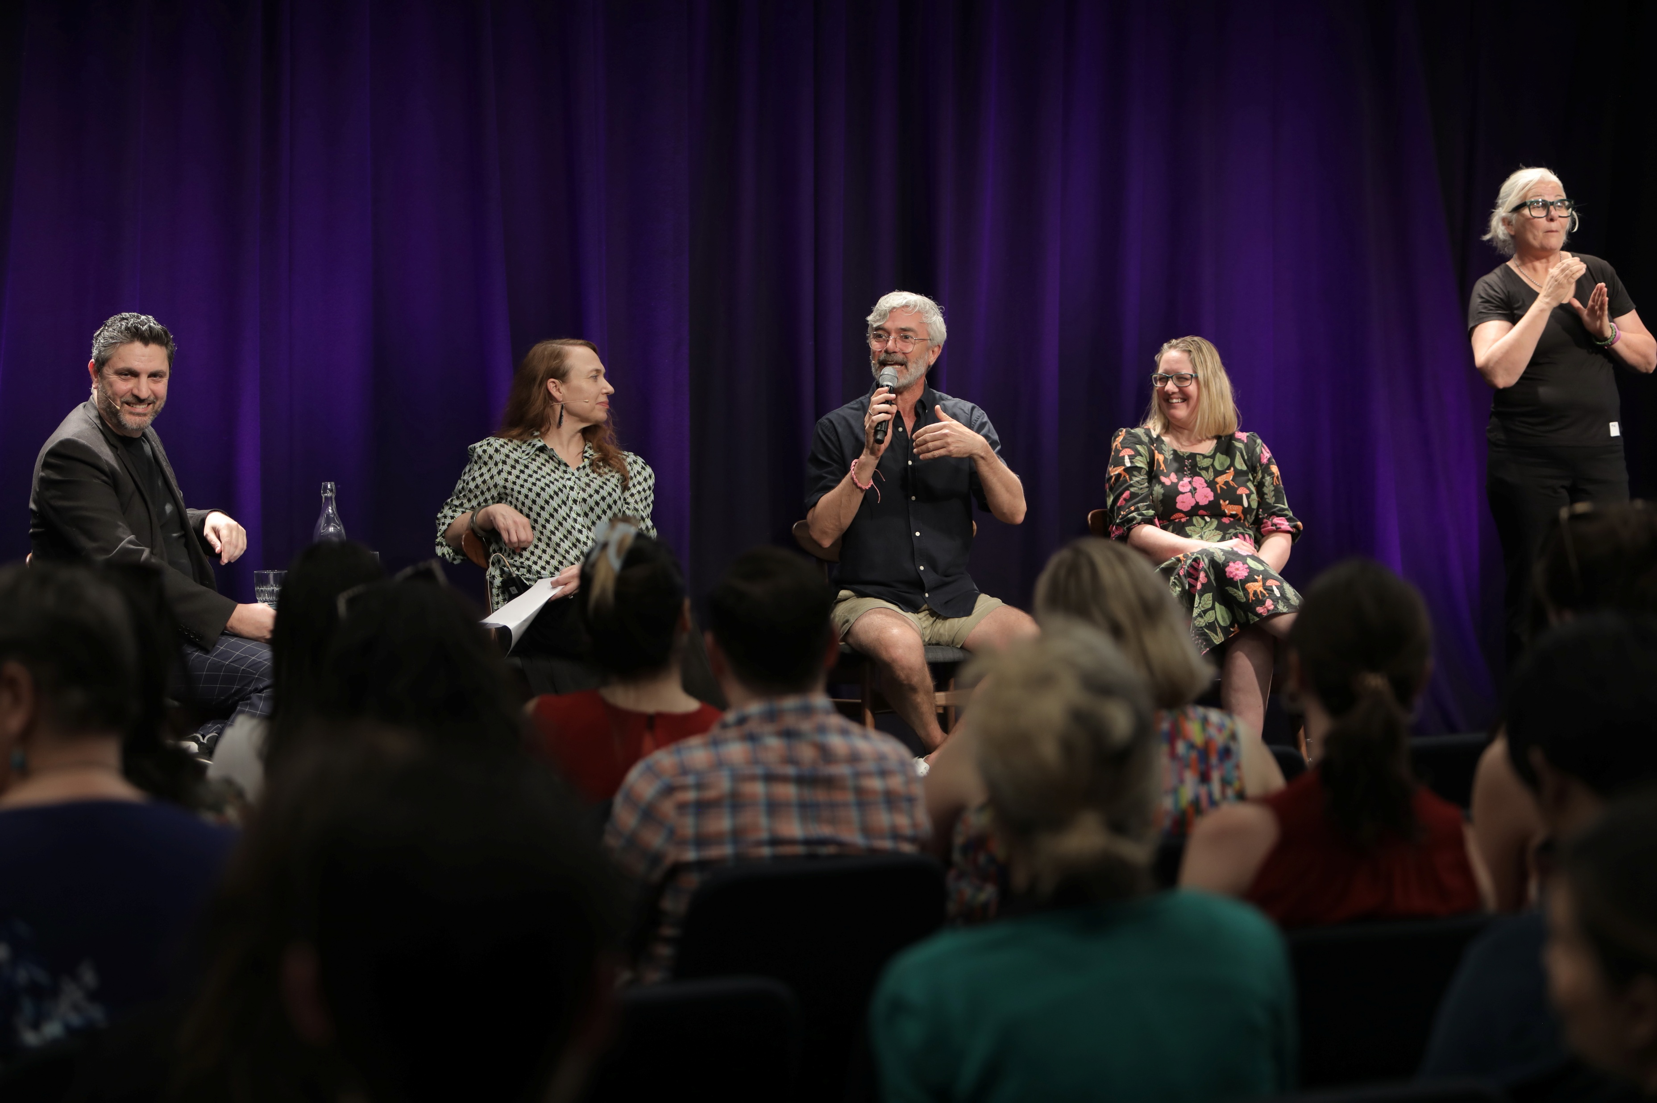
Wellbeing Through Art Event
Access, Ideas, and Insights, presented by Accessible Arts, is a free series of hybrid events. These events are focused on conversations about art, access and inclusion through panel discussions with leading expects in the creative industries.
The event will be held at Bell Shakespeare on Thursday, 15th May. I can join either online or in-person. To attend I must register for a ticket here: Free Ticket Registration
The theme for the event is:
The Neurodiversity Paradigm in Theatre
ACCESSIBLE ARTS | ACCESS, IDEAS AND INSIGHTS: THE NEURODIVERSITY PARADIGM IN THEATRE | VISUAL STORY

Slide 4
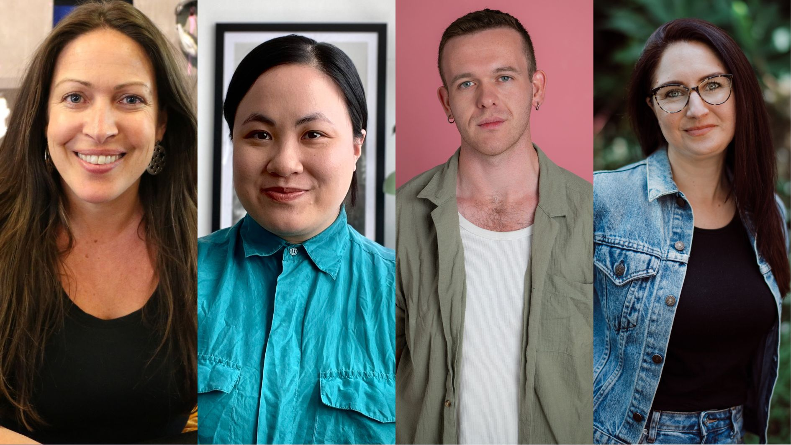
Access Ideas and Insights
The Neurodiversity Paradigm in Theatre
The panel will explore how neurodivergent perspectives are reshaping theatre practices, processes and storytelling.
Panel Includes:
Kylie Heart - Founder and Creative Producer of Midnight Feast
Jules Orcullo - Playwright, Songwriter, and Dramaturg
Ryan Enniss - Award-winning Playwright and Actor
The panel will be MC’d by Joanna Erskine - Head of Education at Bell Shakespeare
ACCESSIBLE ARTS | ACCESS, IDEAS AND INSIGHTS: THE NEURODIVERSITY PARADIGM IN THEATRE | VISUAL STORY

Slide 5
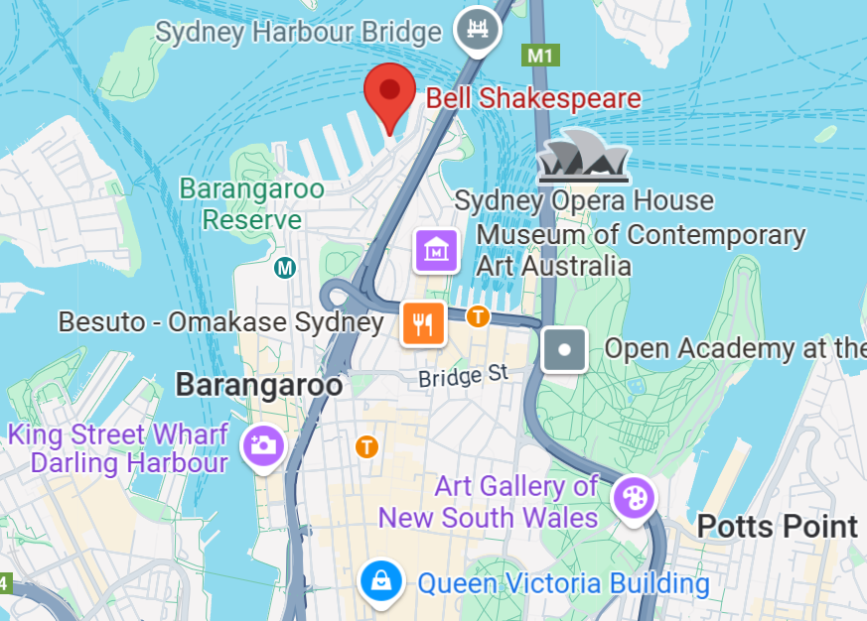
Planning Your Visit
The event will be held in The Seed at Bell Shakespeare. Pier 2/3, Walsh Bay Arts Precinct, Hickson Road, Sydney.
Bus routes 324 & 325: Departs from outside Woolworths at Town Hall and drops off at the entry to Pier 2/3. Returns to Town Hall, picking up on opposite side of the road to the Pier.
Train: Circular Quay and Wynyard are a 15 and 20 min walk from the venue. The direct routes from these transport hubs include significant stairs.
Car parking
There is metered parking available on Hickson Rd, Pottinger St and Lower Fort St.
ACCESSIBLE ARTS | ACCESS, IDEAS AND INSIGHTS: THE NEURODIVERSITY PARADIGM IN THEATRE | VISUAL STORY

Slide 6
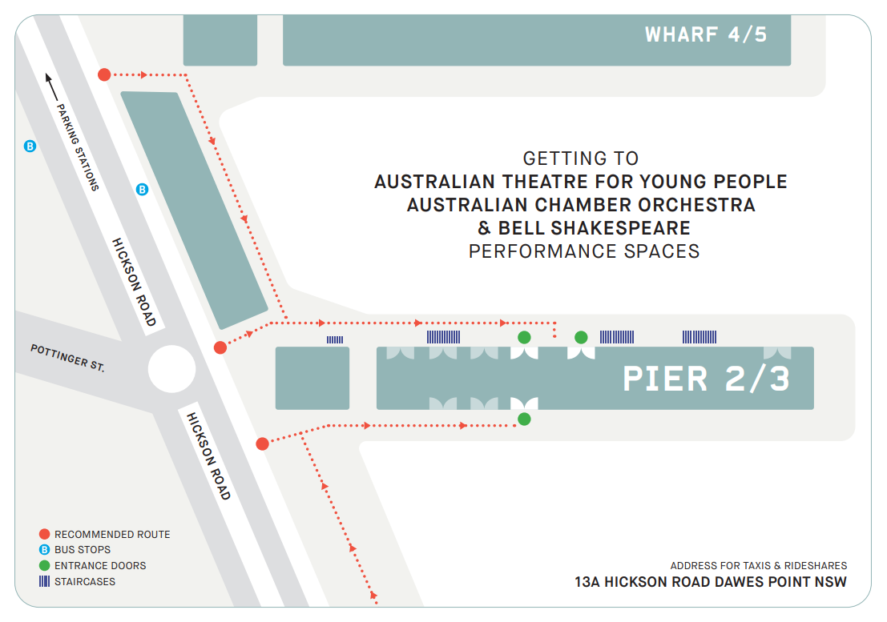
Pier 2/3 Map
This is a map of the of the Pier 2/3 precinct which shows the locations of the entrance, bus stops and staircases. I can follow the recommended route shown in red to locate The Seed at Bell Shakespeare.
I can find more details on getting to the venue via the Bell Shakespeare website: Bell Shakespeare Venue Information
ACCESSIBLE ARTS | ACCESS, IDEAS AND INSIGHTS: THE NEURODIVERSITY PARADIGM IN THEATRE | VISUAL STORY

Slide 7
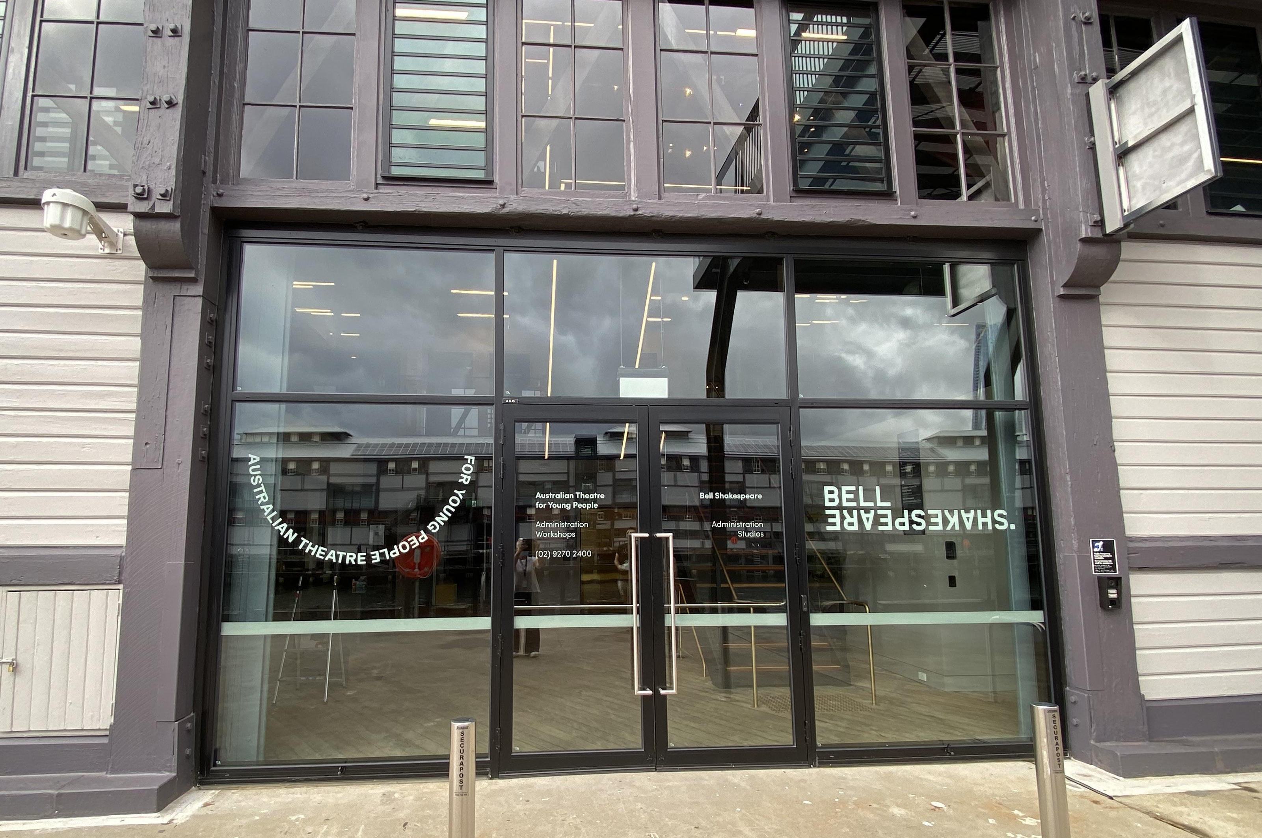
Entrance to Bell Shakespeare
When I arrive via Hickson Rd, I can walk down the pier and enter the Shared Foyer via the glass doors marked Pier 2/3 - Bell Shakespeare performance spaces. These doors are approximately halfway along the pier and will be open to the public.
For a video walk through of Bell Shakespeare’s theatre spaces including where to locate the public accessible toilets, I can watch this video.
ACCESSIBLE ARTS | ACCESS, IDEAS AND INSIGHTS: THE NEURODIVERSITY PARADIGM IN THEATRE | VISUAL STORY

Slide 8
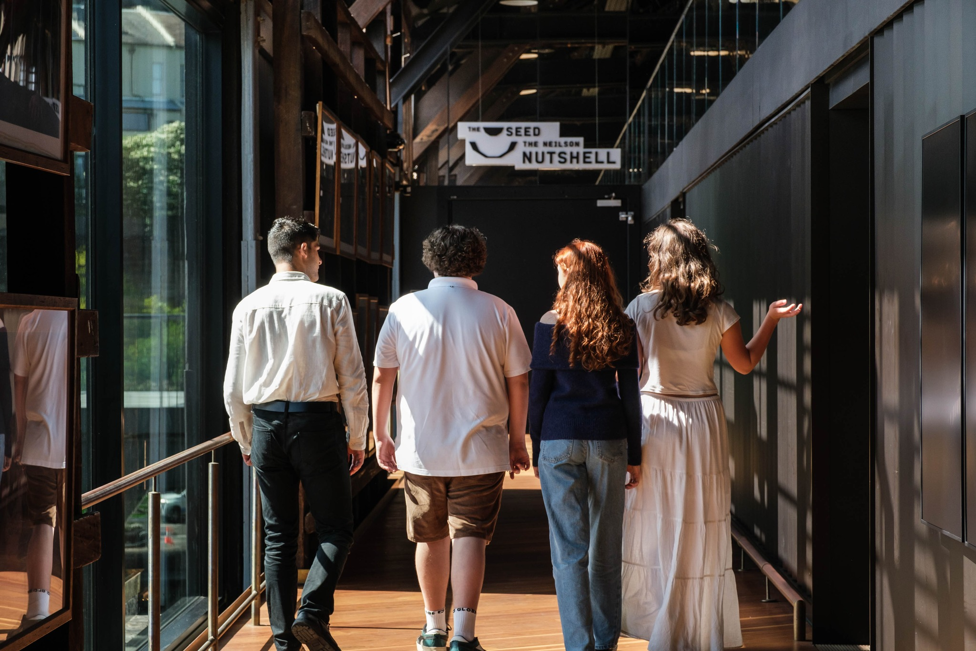
Getting to The Seed
The Seed is on Level 1, and I can get there through the Shared Foyer. From the foyer, I have two options to reach Level 1:
I can take the wide staircase up two flights.
I can use the elevator, which is located right next to the stairs. Both options lead me directly to the Shared Foyer.
Entrance to The Seed is via a wide corridor to the left of the bar. The cloakroom is located on Level 1 at the far-left side of the bar.
ACCESSIBLE ARTS | ACCESS, IDEAS AND INSIGHTS: THE NEURODIVERSITY PARADIGM IN THEATRE | VISUAL STORY

Slide 9
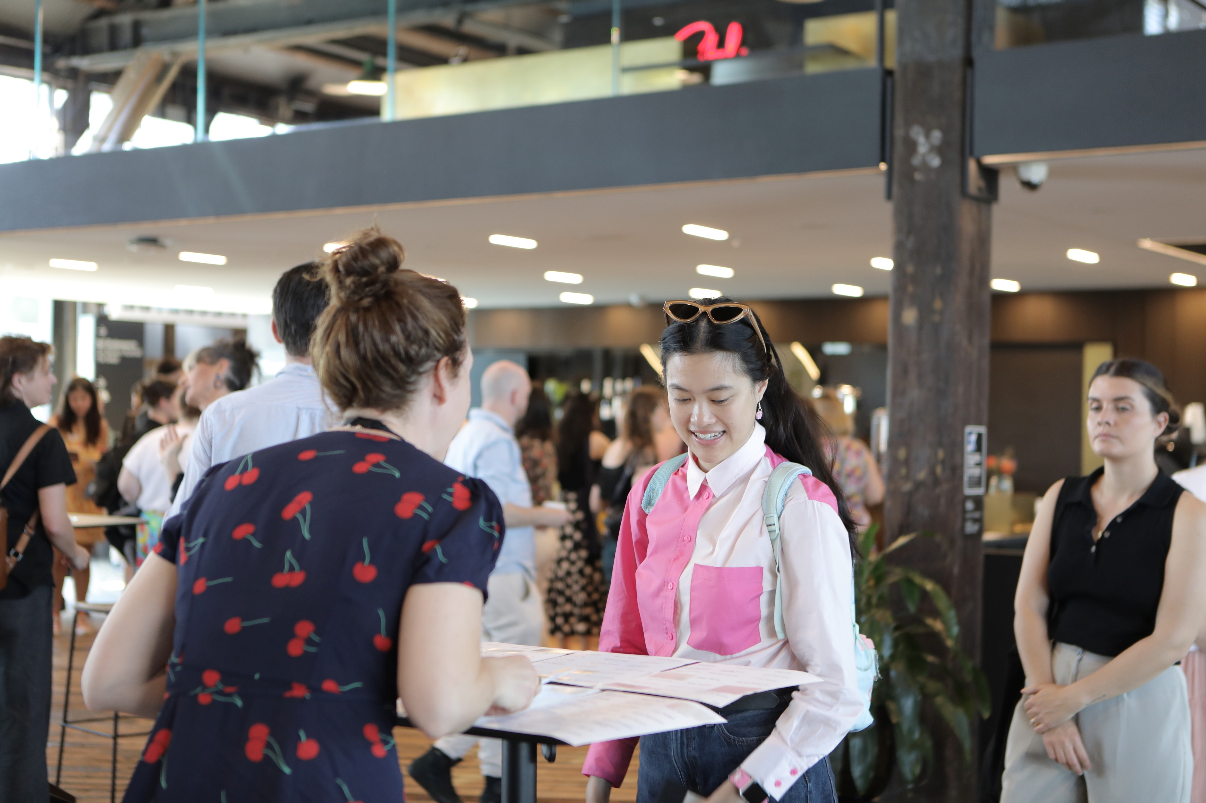
Checking In and Seating
Seating for the event will be general admission floor-level seating. There are no stairs or steps between the elevators and entrance to The Seed.
This is a free event. If I’m attending in person, an Accessible Arts staff member will greet me at the entrance. They’ll check my name off the guest list and give me a sticker with my name on it to wear.
The name sticker helps make networking easier after the panel finishes.
ACCESSIBLE ARTS | ACCESS, IDEAS AND INSIGHTS: THE NEURODIVERSITY PARADIGM IN THEATRE | VISUAL STORY

Slide 10
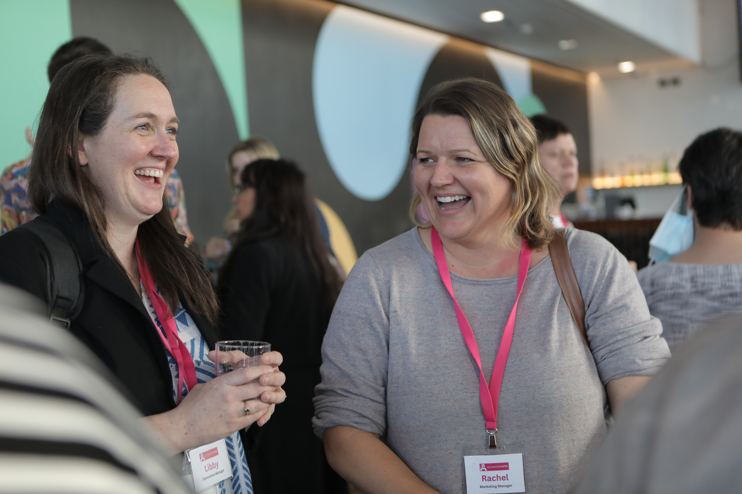
Asking for Help
There will be light music playing in the foyer. I can access free water available at the bar, even if it is closed.
If I need help I can ask either the Bell Shakespeare or Accessible Arts staff who will be working on the event. They will have pink lanyards with their name printed on them.
I cannot take food or drinks with me into the event. If I need to leave the event at anytime I can, and a staff member will help me.
ACCESSIBLE ARTS | ACCESS, IDEAS AND INSIGHTS: THE NEURODIVERSITY PARADIGM IN THEATRE | VISUAL STORY

Slide 11
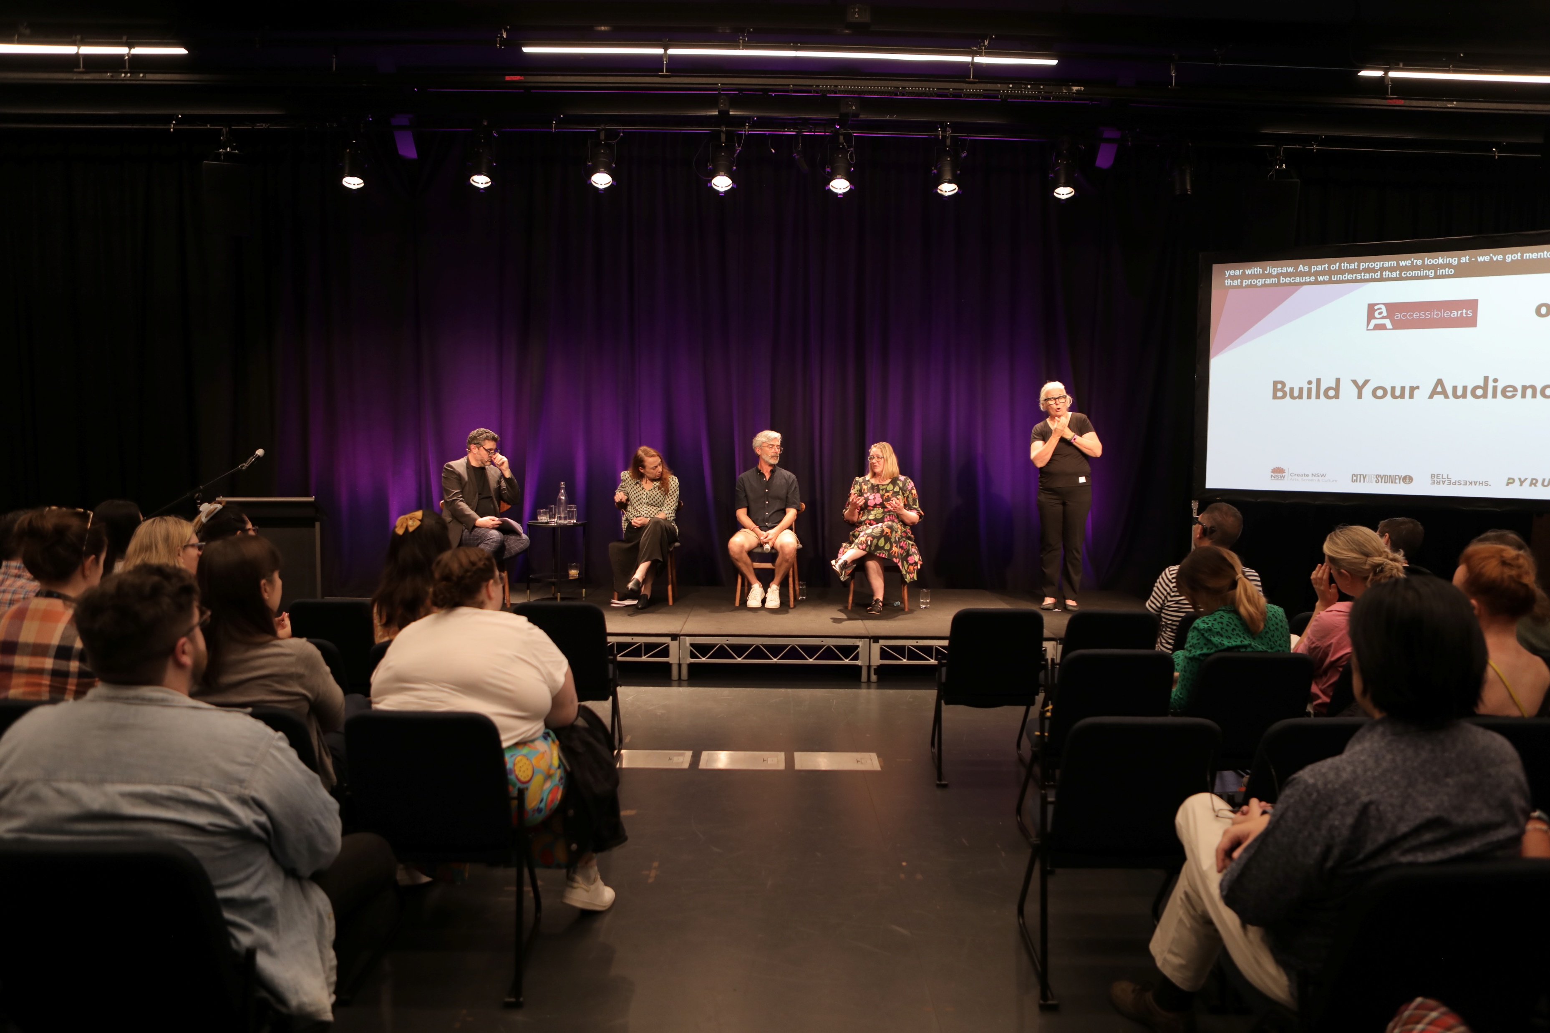
Event Start Time
The doors to the event open at 2:45pm. The event will start at 3pm with a Welcome to Country.
Following the Welcome to Country, a panel discussion featuring four speakers and an MC will take place on stage. The panel discussion will last for 45mins concluding with 15min audience Q&A session where I can ask a question to the panellists.
Free drinks and light refreshments will be provided in the Shared Foyer after the event.
During the event there will be a photographer taking photos, as well as audio and video equipment as the event is being live streamed.
ACCESSIBLE ARTS | ACCESS, IDEAS AND INSIGHTS: CREATIVE PARTNERSHIPS & PATHWAYS | VISUAL STORY

Slide 12
Access at the Event
The event will be Auslan interpreted and live captioned.
If I need an accessible seat, I can approach the Accessible Arts staff member, and they will be help me find one.
If I want to ask about specific access requirements before the event, I can reach out to the Accessible Arts team by clicking here: Contact Us
ACCESSIBLE ARTS | ACCESS, IDEAS AND INSIGHTS: CREATIVE PARTNERSHIPS & PATHWAYS | VISUAL STORY

Slide 13
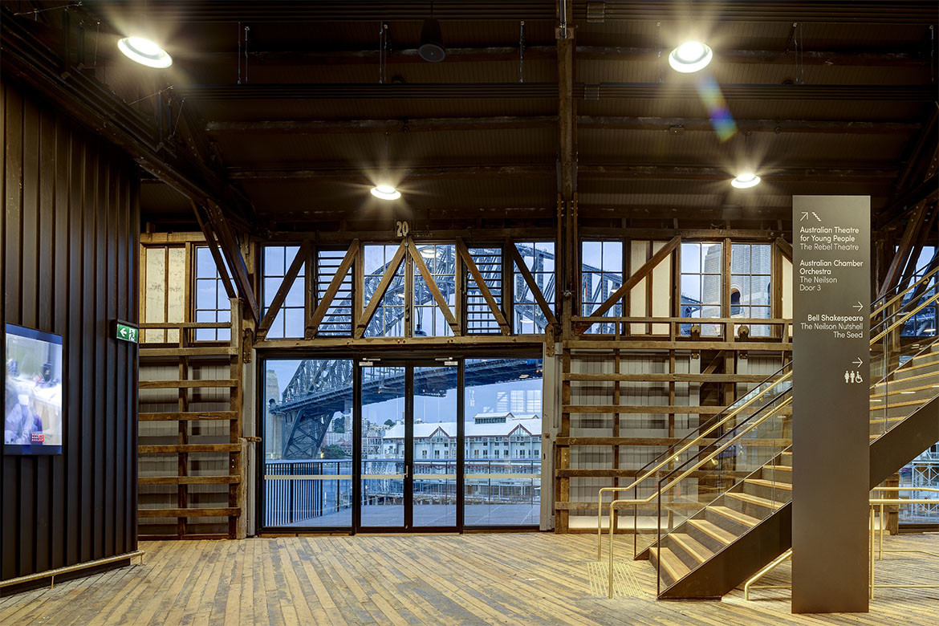
Leaving the event and Pier 2/3
When the event finishes, I can leave the venue in the same way I arrived. I can walk down the corridor, back down to ground floor via the stairs or lift, out onto the pier and then on to Hickson Rd.
I can explore the Walsh Bay Arts Precinct, enjoy a coffee nearby and enjoy Sydney Harbor. If I want to find out more about Bell Shakespeare future events I can look up their What’s On page here: Bell Shakespeare events.
ACCESSIBLE ARTS | ACCESS, IDEAS AND INSIGHTS: CREATIVE PARTNERSHIPS & PATHWAYS | VISUAL STORY

